Slide 1

RAJKIYA ENGINEERING COLLEGE
AZAMGARH
Project Presentation
on
THYROID PREDICTION SYSTEM
Presented to:
Submitted By-
Dr. Tauseef Ahmad
(Head of Department - IT)
Mr. Waseem Ahmad
(Guest Faculty- IT)
PANKAJ PATEL (1773613031)
SHASHWAT PAL (1773613050)
RUDRA PRATAP SINGH (1773613040)
GAUTAM KUMAR (1873613903)

Slide 2
TOPICs TO BE DISCUSSED
Introduction
Objective
Techniques & Algorithms
User interface
Language & Libraries
Attributes of Datasets
Support vector machine
Decision Tree
Random forest
K-Nearest Neighbor
Requirements
Methodology used
Visualization of Dataset
Input / Output
Advantage
Disadvantage
Conclusion
Future scope and References

Slide 3
INTRODUCTION
We are applying machine learning to maintained complete hospital data Machine learning technology which allows building models to get quickly analyze data and deliver results faster. Healthcare is the most prime example of how machine learning is use in medical field.
To improve the accuracy from a large data, the existing work can be used on unstructured and textual data. For prediction of diseases the existing system will work on the model with highest accuracy.

Slide 4
OBJECTIVE
Provide an efficient solution for healthcare practitioners via Logistic Regression for a particular thyroid disease that a person may have.
Finding an accurate solution to this problem is a must.
This tool will cause an immense decrease in misdiagnoses as it is capable of distinguishing between problems of the thyroid gland and other illnesses in the body.
As well as providing the ability to detect the disease before it forms into a more destructive anomaly.
In the end result, the patient will be classified to have either of the following:
Hyperthyroid, Hypothyroid, Sick, Negative.

Slide 5
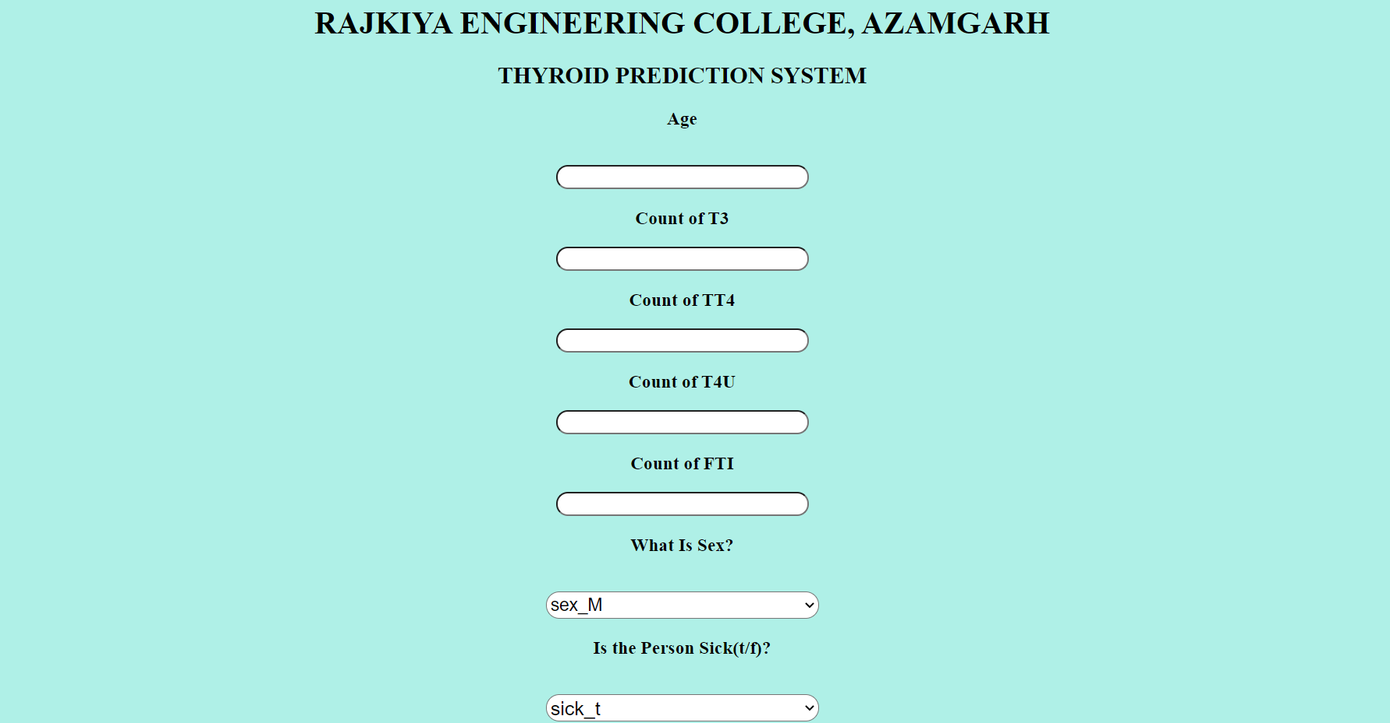
User Interface

Slide 6
TECHNIQUE AND ALGORITHMS
Techniques Used - We have used SVM, Random Forest, KNN and Decision tree model. Using these models, we select the model with highest accuracy for our Thyroid prediction system to predict thyroid disease for the patient.
Predictive Model Technique- We have used Random forest model as the predictive model because it has the highest accuracy.

Slide 7
.
Language AND Libraries
Python 3x
Pandas: Powerful data structures for data analysis, time series, and statistics.
Numpy: A general-purpose array-processing package designed to efficiently manipulate large multi-dimensional arrays.
Scikit-Learn: Simple and efficient tools for data mining and data analysis.
Seaborn: A library for making statistical graphics in Python.
Matplotlib: Python plotting package.

Slide 8
attributes of Datasets
age: continuous.
sex: M, F.
on thyroxine: f, t.
query on thyroxine: f, t.
on antithyroid medication: f, t.
sick: f, t.
pregnant: f, t.
thyroid surgery: f, t.
I131 treatment: f, t.
query hypothyroid: f, t.
query hyperthyroid: f, t.
lithium: f, t.
goitre: f, t.
tumor: f, t.
hypopituitary: f, t.
psych: f, t.
TSH measured: f, t.
TSH: continuous.
T3 measured: f, t.
T3: continuous.
TT4 measured: f, t.
TT4: continuous.
T4U measured: f, t.
T4U: continuous.
FTI measured: f, t.
FTI: continuous.
TBG measured: f, t.
TBG: continuous.

Slide 9
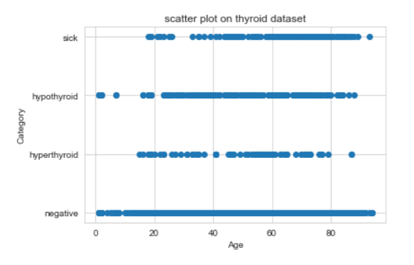
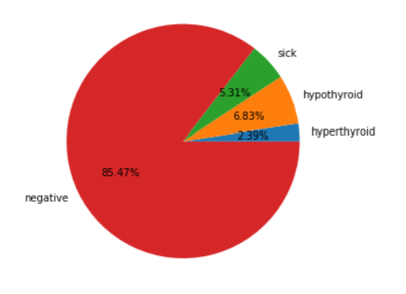
Visualization

Slide 10
K Nearest Neighbor
The k-nearest neighbors (KNN) algorithm is a simple, supervised machine learning algorithm that can be used to solve both classification and regression problems. It's easy to implement and understand, but has a major drawback of becoming significantly slows as the size of that data in use grows.
Learning is carried out by comparing a given test set with training sets that are similar.

Slide 11
Support Vector Machine( SVM)
A support vector machine (SVM) is a supervised machine learning model that uses classification algorithms for two-group classification problems. After giving an SVM model sets of labeled training data for each category, they're able to categorize new text.
SVM are typically used for binary classification or classifying between two classes.

Slide 12
Decision Tree
A decision tree is a decision support tool that uses a tree-like model of decisions and their possible consequences, including chance event outcomes, resource costs, and utility. It is one way to display an algorithm that only contains conditional control statements.
A decision tree is a diagram or chart that helps determine a course of action or show a statistical probability. Each branch of the decision tree represents a possible decision, outcome, or reaction.

Slide 13
Random Forest
A random forest is a machine learning technique that's used to solve regression and classification problems. It utilizes ensemble learning, which is a technique that combines many classifiers to provide solutions to complex problems. A random forest algorithm consists of many decision trees.
A Random Forest is an ensemble technique capable of performing both regression and classification tasks with the use of multiple decision trees and a technique called Bootstrap and Aggregation, commonly known as bagging

Slide 14
METHODOLOGY USED
Data Pre-processing- Importing of raw data, python libraries.
Data Filtration- Data cleaning, data minimization.
Exploratory Data Analysis(EDA)- To make sense of the data & features.
Building models- Using Random forest technique.
Performance evaluation- Accuracy, Classification report, Confusion Matrix.
Thyroid Data Set
SVM,
Random forest, Decision Tree,
KNN
Applied
Data Pre- Processing
Result/ Prediction
Model with maximum accuracy is used (Random forest)

Slide 15
REQUIREMENTS
Jupyter Notebook
Jinja2==2.10.1
MarkupSafe==1.1.1
Werkzeug==0.15.5
numpy>=1.9.2
scipy>=0.15.1
scikit-learn>=0.18
pandas>=0.19
Flux
Flux Core

Slide 16
Input/ Output
All the input of attributes are entered in order to predict if a person with these input have hyperthyroid, hypothyroid, sick or negative.
The attributes that are entered are:
Age, Sex, Sick, Pregnant , Thyroid Surgery , Goitre , Tumor, T3 , TT4 , T4U , FTI .

Slide 17
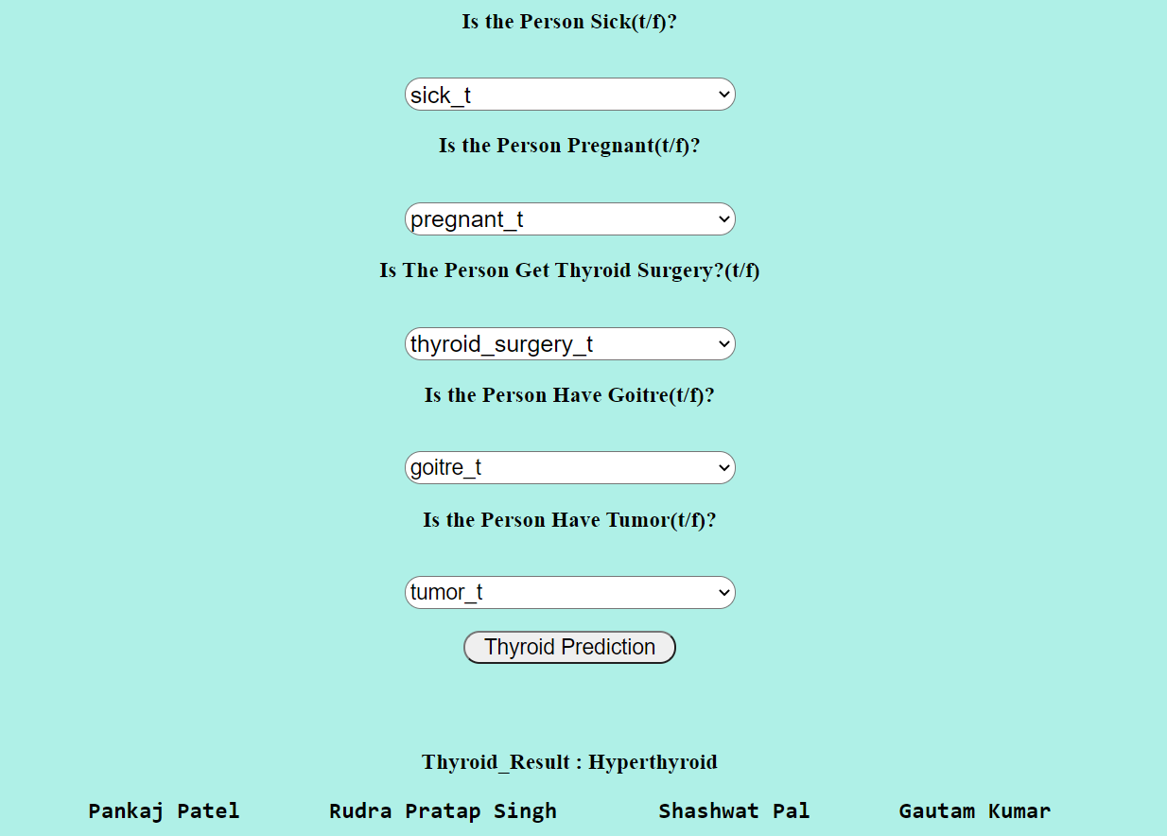
Output with example

Slide 18
MERITS
The patient do not have to consult a doctor necessarily.
Provide help to a professional practitioner.
Combination of Knowledge and Expertise from Various Sources.
Consistency of the system.
Ability to Solve Complex and Difficult Problems.

Slide 19
LIMITATIONS
It is not very effective in case of small data.
Require high knowledge of machine learning development.
It is difficult to maintain the system.
It is not widely used at present.

Slide 20
CONCLUSION
Thyroid Prediction System using Machine Learning is a project idea that aims on being a smart and precise way to predict thyroid disease.
We have made use of Random forest technique to train our dataset and to predict thyroid disease with more accuracy.
Here the machine is trained to detect whether the person is normal, or has hyperthyroid, hypothyroidism, sick based on the user’s input. So when user enters data in web page the data will be processed in backend (model) and the result will be displayed on the screen.
Our objective was to give society an efficient and precise way of machine learning which can be used in applications aiming to perform disease detection.

Slide 21
FUTURE SCOPE
Can be used in android application in future for Thyroid patient.
We can use image processing of ultrasonic scanning of thyroid images to predict thyroid nodules and cancer.
We can enhance the accuracy of our system by using different algorithms/techniques.

Slide 22
REFERENCE
Chen Ling, Li Xue, Sheng Quan Z, Peng W-C (2016) Mining health examination records—a graph-based approach. IEEE Trans Knowl Discov Eng 28:2423–2437
Temurtas F (2009) A comparative study on thyroid disease diagnosis using neural networks. Expert Syst Appl 36:944–949
Ulutagay G (2012) Modeling of thyroid disease: a fuzzy inference system approach. Wulfenia J 19(1):346–357
Monaco Fabrizio (2003) Classification of thyroid diseases: suggestions for a revision. J Clin Endocrinol Metab 88:1428–1432
Ionita I, Ionita L (2016) Prediction of thyroid disease using data mining techniques. Broad Res Artif Intell Neurosci 7(3):115–124
https://www.researchgate.net/publication/341534298

Slide 23
Thank You

